Slide 1
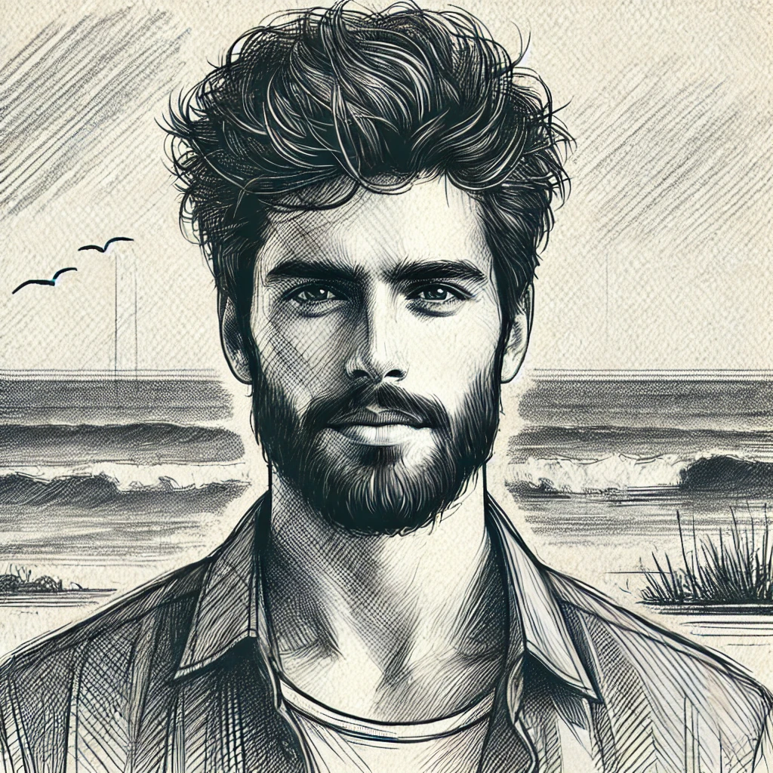
Persona Profile – Nikos Georgiou
| 📍 Paphos, Cyprus | 🧑‍💻 Freelance Web Developer | 🌍 Eco-Conscious Digital Nomad |
| 💰 Income: €40,000/year | 🎓 Education: M.Sc. Computer Science |
🛠 Work & Lifestyle
- Left corporate tech for freedom & creativity
- Works remotely in eco-tourism & UX/UI
- Slow traveler, prefers authentic & local experiences
🎯 Motivations & Priorities
✅ Authenticity & Sustainability (30%)
✅ Meaningful Travel (25%)
✅ Work-Life Balance (20%)
✅ Local Cultural Connection (15%)
✅ Lifelong Learning & Creativity (10%)
📱 Travel & Tech Behavior
🟢 Uses Tourmate, Duolingo, Airbnb, Waze GPS
🟢 Relies on offline maps, eSIMs, power banks
🟢 Engages in Nomad List, Reddit (r/digitalnomad), Eco-Travel Meetups
🤝 Key Decision-Making Factors
🌱 Authenticity & Sustainability | 📱 Tech Convenience | 👥 Community Trust

